Slide 1
Cool Microcontroller Projects FRS Repeater Controller
Dave VE3OOI
Feb 2021

Slide 2
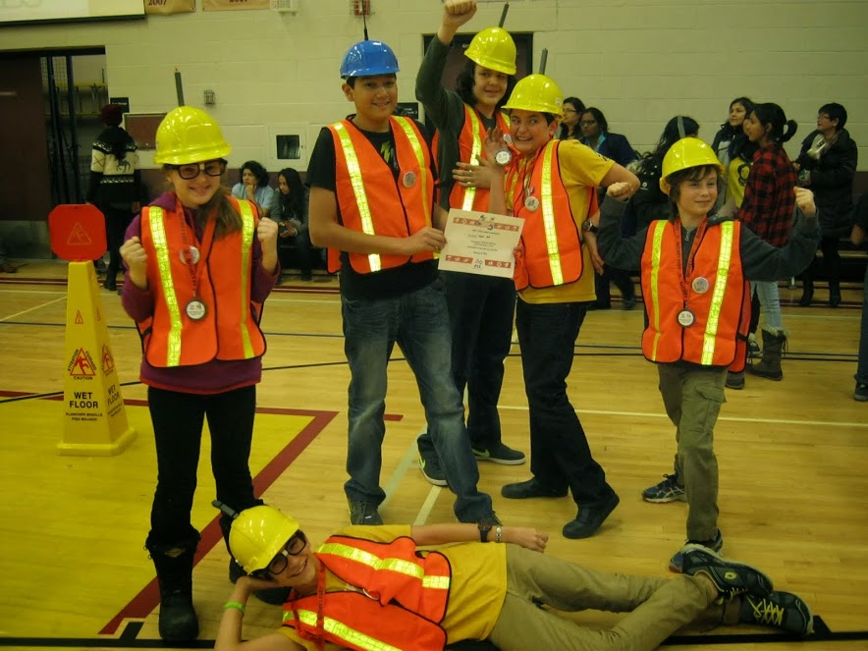
BACKGROUND
Tyler got his ticket (VA3TJR). Studying TV Broadcasting
Kyle is studying Actuarial Science
Lost touch with Michael
First Lego League Project
Amateur Radio Theme
Using a Balloon with a repeater during emergency
Presented idea to PARC
Isaac is started Engineering this year
Tatum is in 2nd Year
Physics
Max continues to be a Trump supported – Final year in BioChem

Slide 3
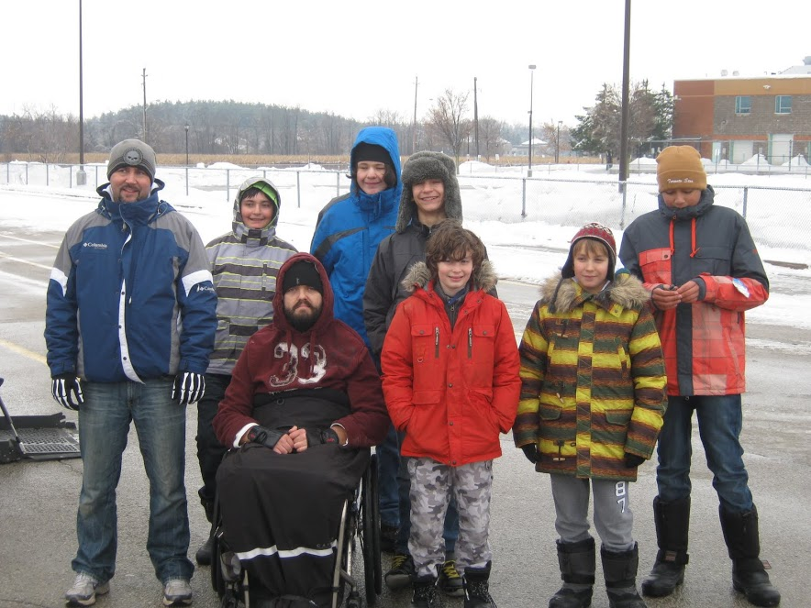
Noodling
Use FRS radios to relay in simplex mode
Transmit from one radio, record message, then play it back
Need VOX to detect signal
Decided to use ISD 1760 Multimessage voice recorder and playback chip
Controlled via SPI or Pushbuttons
Easier to use pushbutton (via I/O pins)

Slide 4
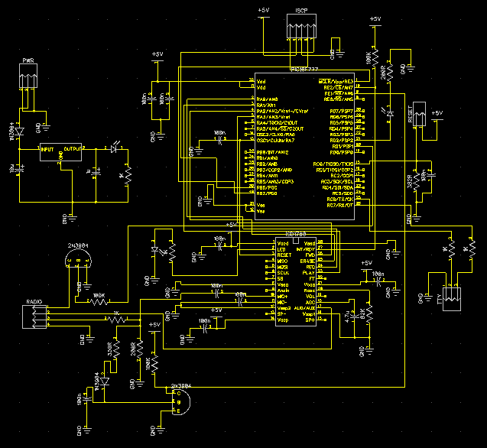
CIRCUIT

Slide 5
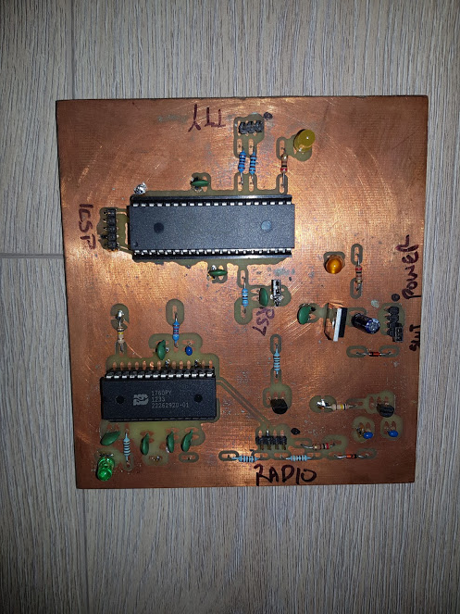
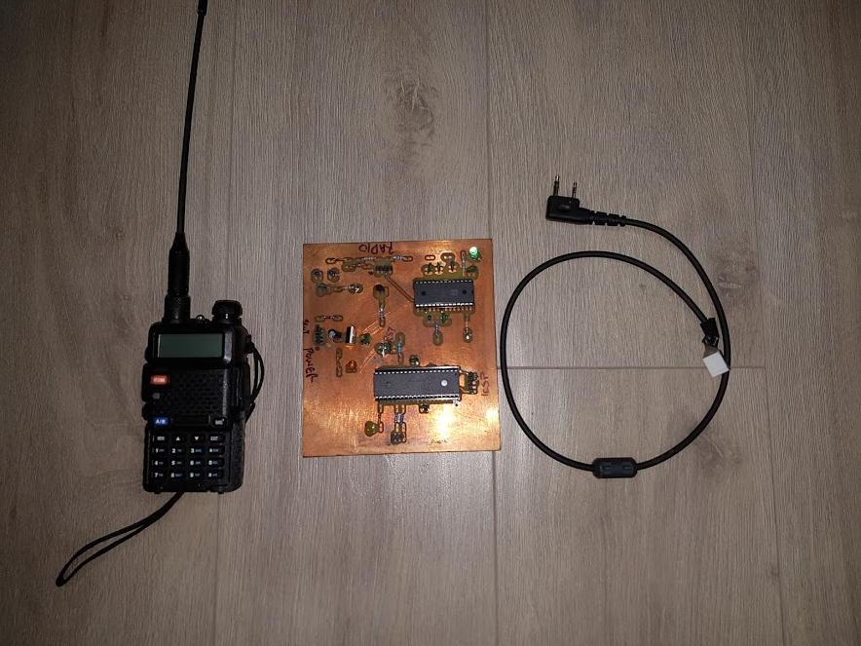
BUILD
PIC16F777
ISD 1760
Choke

Slide 6
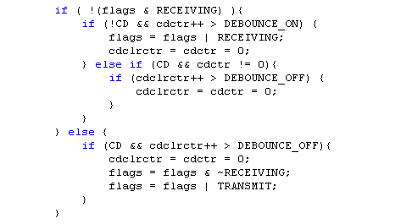
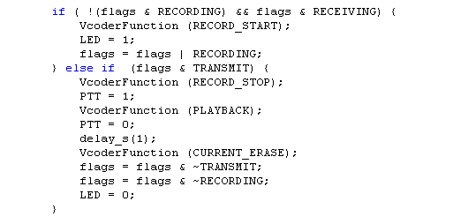
SOFTWARE
If VOX detected carrier. Set to RECEIVE mode. CD = 0 for ON
Receive or Transmit
PIC16F777
If no carrier after receiving. Set to TRANSMIT mode. CD = 1 for OFF
ISD 1760
If receiving voice. Set ISD1760 to record.
Record or Playback
If voice recording and CD not present then stop recording and enable PTT and set ISD1760 to playback. When finished erase.

Slide 7
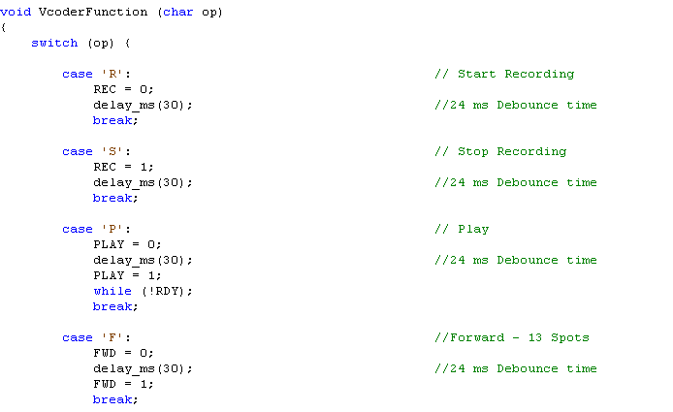
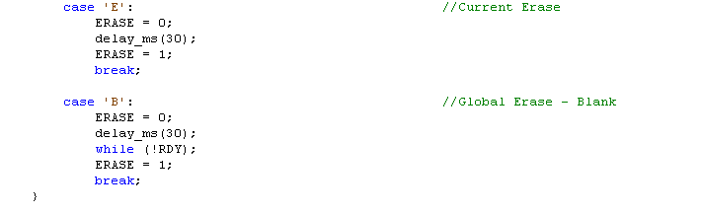
ISD1750
REC, PLAY, FWD, ERASE are all PIC uController PINs that act like a push button
PIC16F777
During playback, “block” until playback is finished
RDY is a signal from ISD1760 for function complete
ISD 1760
During erase, “block” until erase is finished

Slide 8
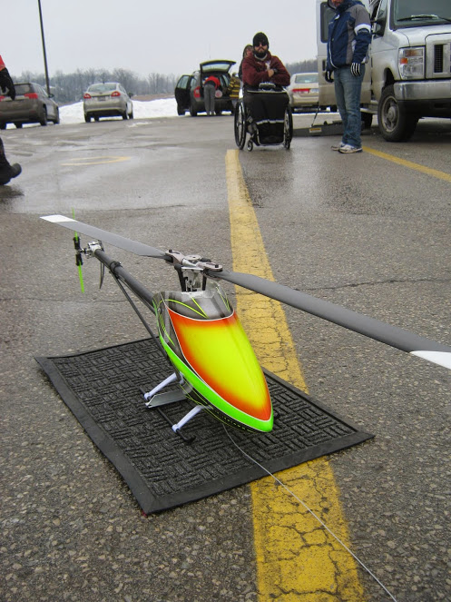
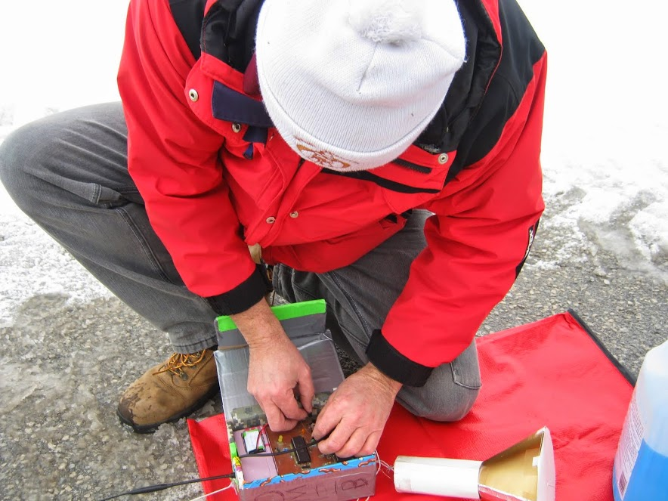
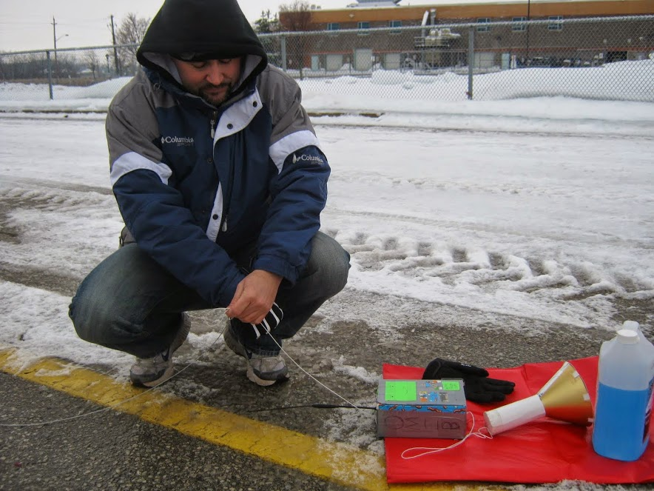
TESTING

Slide 9
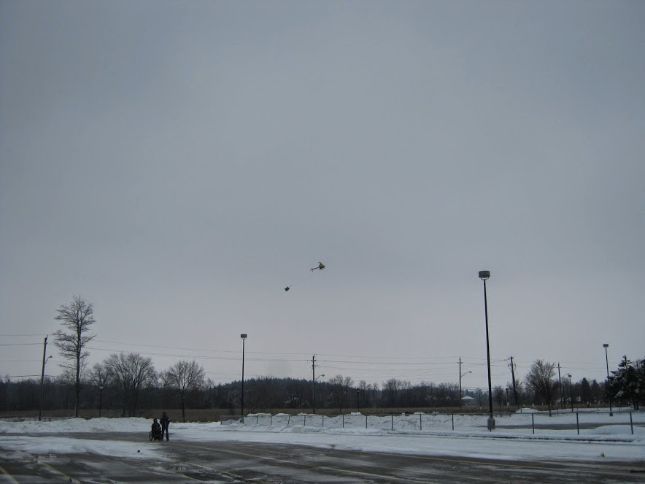
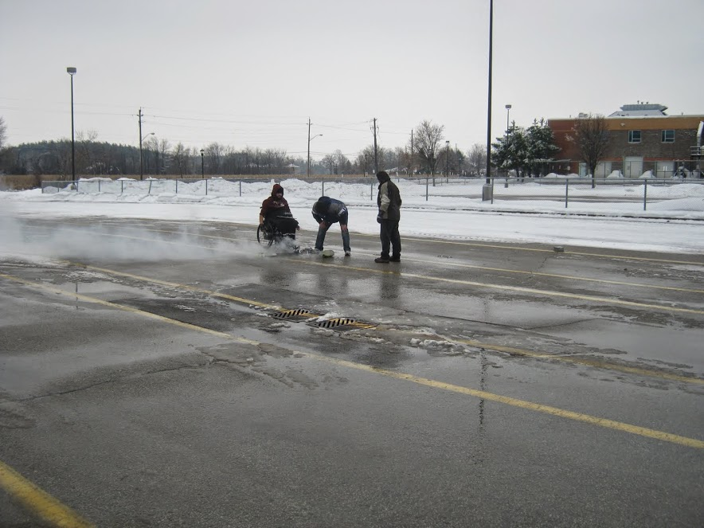
BAD DAY TO GO FLYING

Slide 10
FIN

